Slide 1
Epicardial catheter ablation for life threatening ventricular arrhythmia in Brugada syndrome
2022년 12월 3일 VT symposium
Yae Min Park, M.D.
Cardiology Division, Gachon University Gil Hospital

Slide 2
Case 1
M/52 yrs
BHx>
Seizure like movement during sleeping, Visit other hospital
sudden cardiac arrest & VF
Resuscitated after CPR and defibrillation
2 years prior to admission; seizure like movement
FHx of syncope or SCD> none

Slide 3
Initial ECG at other hospital

Slide 4
VF at other hospital

Slide 5
ECG at ER

Slide 6
ICD implantation; secondary prevention

Slide 7
Appropriate shock d/t VF

Slide 8
Appropriate shock d/t VF
Quinidine 300mg tid

Slide 9
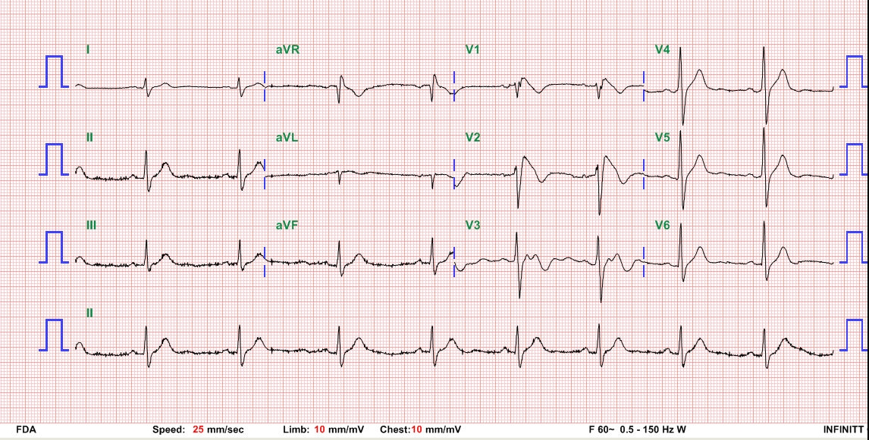
ECG; consistent Brugada type I

Slide 10
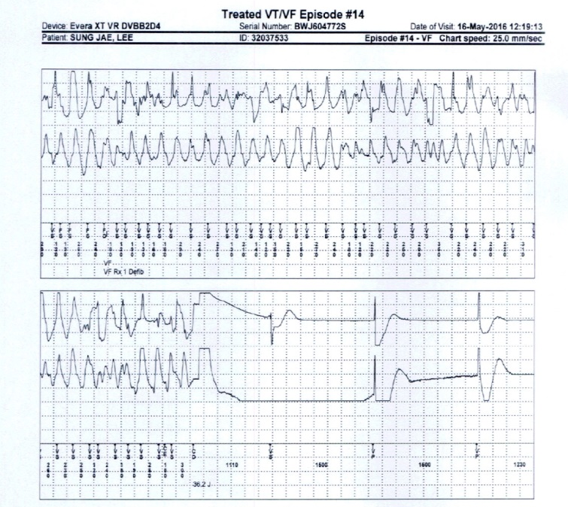
Appropriate shock d/t VF during quinidine

Slide 11
What is your next option?

Slide 12
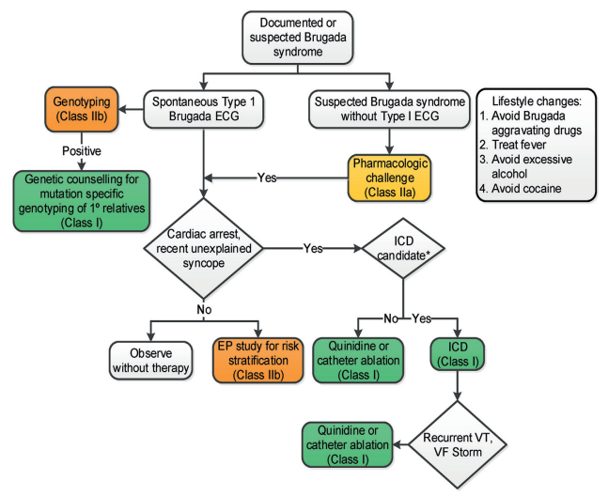
Prevention of SCD in BrS
JACC 2017 VA/SCD guideline
Notes:
The present task force is concerned that this could result in an over-diagnosis of BrS, particularly in patients displaying a Type 1 ECG only after a drug challenge.
Accordingly, we recommend adoption of the following diagnostic criteria and score system for BrS

Slide 13
Recommendations for BrS
JACC 2017 VA/SCD guideline
Notes:
The present task force is concerned that this could result in an over-diagnosis of BrS, particularly in patients displaying a Type 1 ECG only after a drug challenge.
Accordingly, we recommend adoption of the following diagnostic criteria and score system for BrS

Slide 14
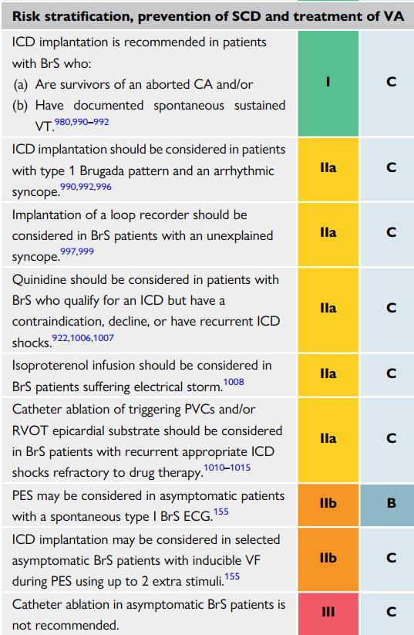
Recommendations for BrS
2022 ESC guideline VA and prevention of SCD
Notes:
Catheter ablation may be considered in patients with a history of electrical storms or repeated appropriate ICD shocks. 2015 ESCguideline

Slide 15
Catheter ablation for BrS
Endocardial ablation of ventricular ectopy (RVOT or purkinje) prevented VF.
Circulation 2003;108:925
Notes:
Haı ¨ssaguerre et al. were the first to attempt catheter ablation from the endocardial site to treat patients with BrS with recurrent VF.101 Patients with BrS rarely have PVCs making this approach impractical

Slide 16
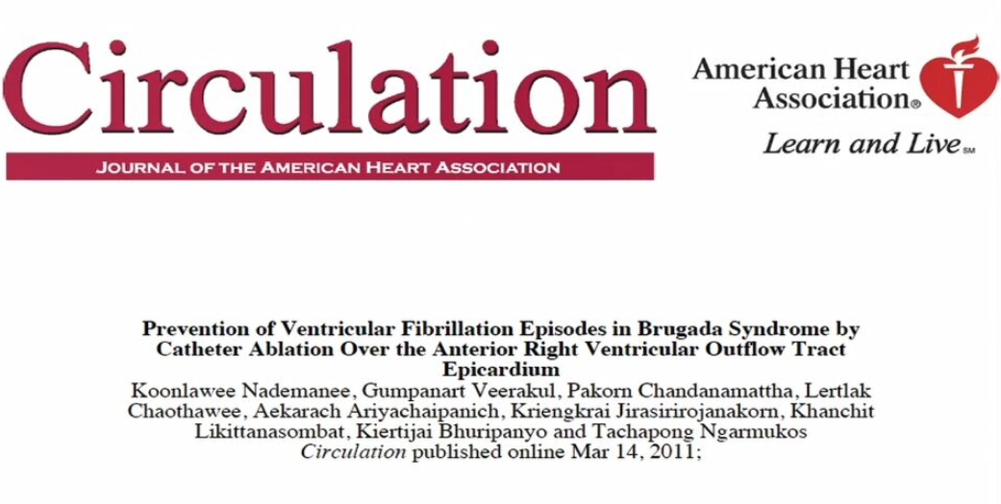
Catheter ablation for BrS
; epicardial substrate modification
Circulation 2011;123:1270
Notes:
Nademanee et al. have presented the first series showing that electrical epicardial substrate ablation in the RVOT can prevent VF inducibility in a high-risk population.

Slide 17
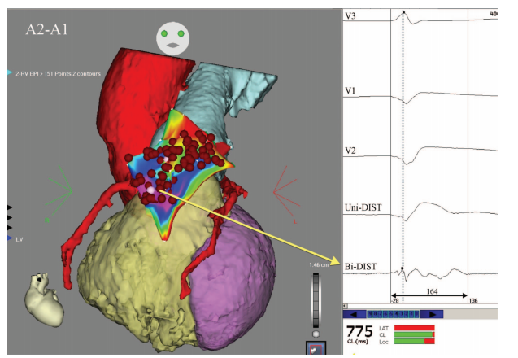
Low voltage, prolonged duration of the fractionated electrogram >150ms
Circulation 2011;123:1270
Notes:
The double annotation map displays a magnitude of prolonged electrogram duration; the purple area indicates the very prolonged duration of the electrogram (150 ms). The sample electrograms recorded from this area are shown (right). The bipolar electrogram recorded from the distal pair-electrodes of the NaviStar-ThermoCool catheter at the purple area of the map is low voltage (0.43 mV) and fractionated with the electrogram width of 164 ms. The unipolar electrogram recorded from the distal electrode is also shown, along with the right precordial leads (V1 through V3). The red dots represent ablation points;
The most common definitions for the Brugada substrate were low voltage areas <1.5 mV, late potentials, and fragmented potentials. Nademanee et al.8) defined epicardial substrate as low voltage areas <1.0 mV; split EGMs or fractionated EGMs; wide duration >80 ms or late potentials extending beyond the end of the QRS

Slide 18
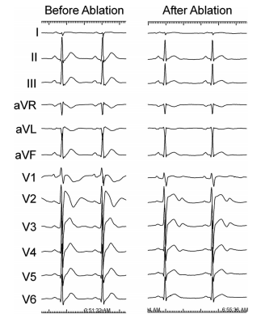
Normalization of Brugada ECG pattern after the end of successful procedure
Circulation 2011;123:1270
Notes:
Postprocedure, predischarge, and follow-up 12-lead ECG confirmed the absence of BrS ECG pattern before and after flecainide test in all patients and after a median follow-up of 5 months ECG remained normal despite flecainide testing.

Slide 19
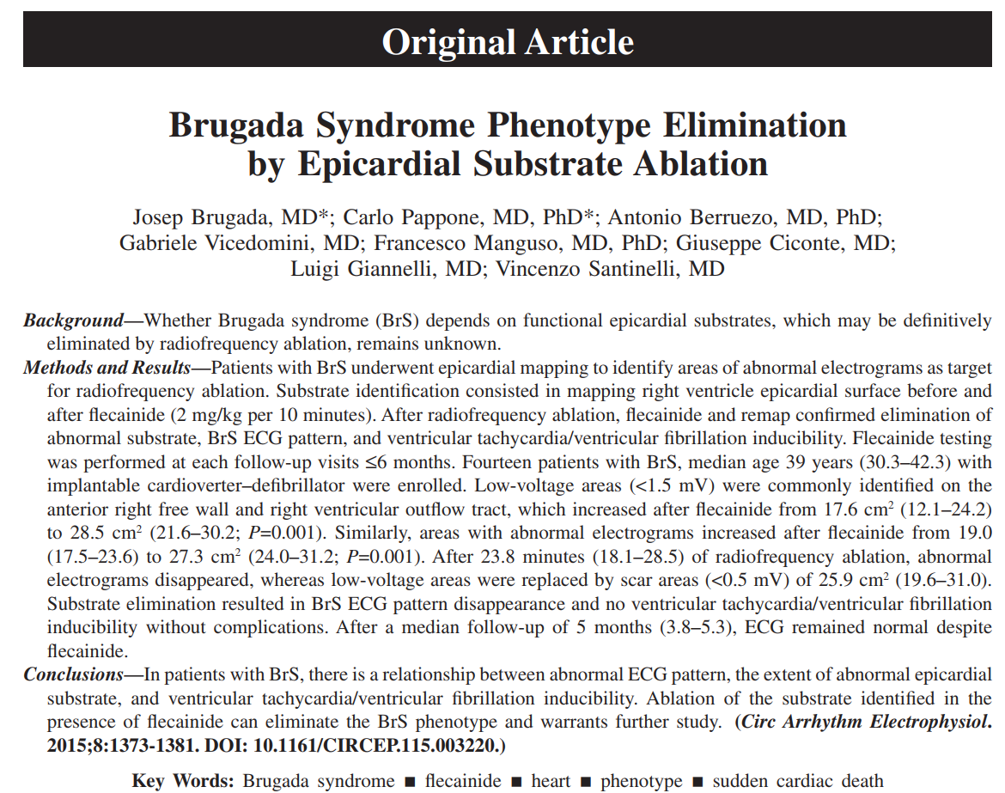
Notes:
Recently, a study focused on epicardial ablation has been published showing an apparent elimination of the BrS ECG phenotype.

Slide 20
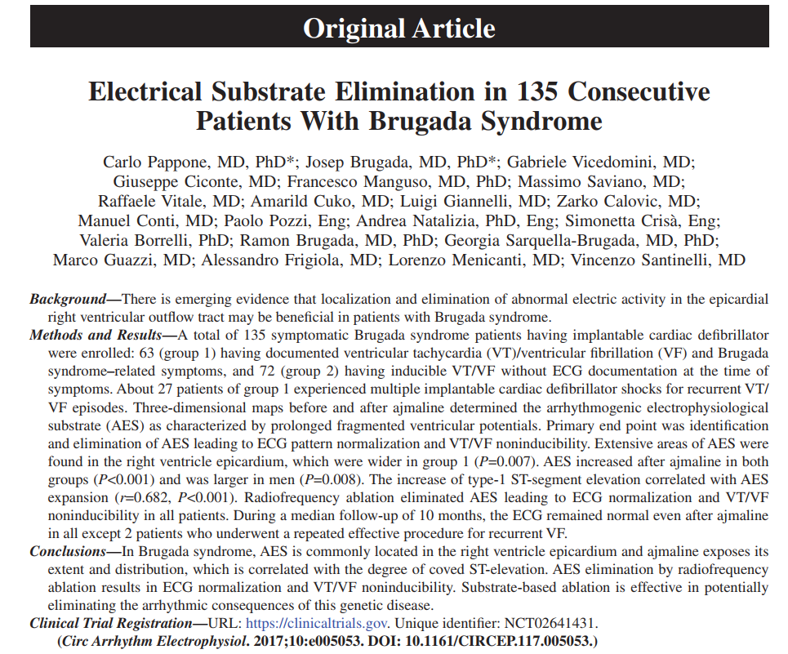
Notes:
Recently, a study focused on epicardial ablation has been published showing an apparent elimination of the BrS ECG phenotype.

Slide 21
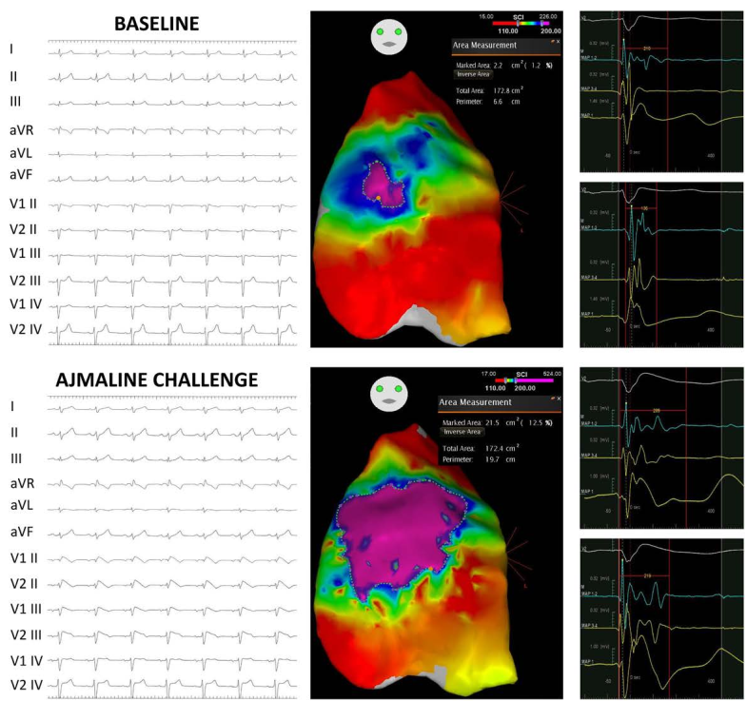
Color coded duration map
Outcome after catheter ablation
Notes:
Baseline BrS-ECG pattern and epicardial color-coded duration CARTO maps. A saddle-back pattern is evident in V2 (II intercostal space) with a corresponding small (2.2 cm2) purple area of abnormally prolonged potentials (210 ms in the example). The border-zone area (green/blue area >110 and <200 ms) shows potentials with relatively shorter duration (136 ms). Middle, BrS-ECG pattern and color-coded duration maps after ajmaline. After type 1 ajmaline-induced (Continued)
ECG pattern, the abnormal purple area significantly increased to 21.5 cm2. Examples of abnormal and prolonged electrograms found in the purple area after ajmaline test are shown beside the map (289 and 219 ms)

Slide 22
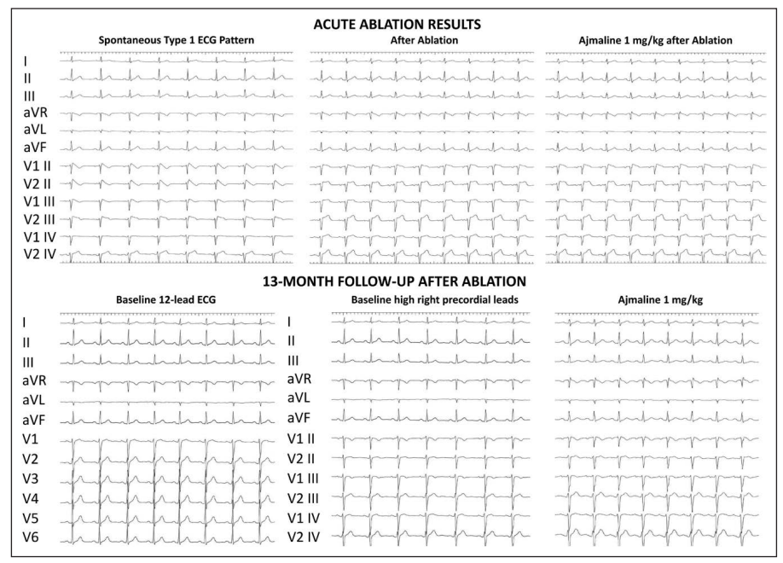
ECG changes after ablation
1. AES is commonly located in the right ventricle epicardium and ajmaline exposes its extent and distribution, which is correlated with the degree of coved ST-elevation.
2. AES elimination by ablation results in ECG normalization and VT/VF noninducibility.
3. Substrate-based ablation is effective in potentially eliminating the arrhythmic consequences of this genetic disease.
Notes:
Persistent ECG pattern normalization without VF inducibility, even after repeated ajmaline challenge, suggested that substrate ablation can be considered as a potential therapy for preventing recurrent VT/VF.
rrhythmogenic electrophysiological substrate

Slide 23
Catheter ablation without ICD??
Should be performed in symptomatic patients with ICD back up

Slide 24
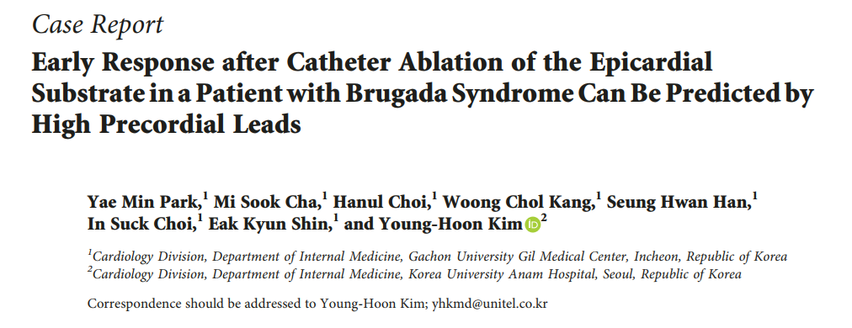
Case
Case Rep Cardiol 2018;2018:5980380
Notes:
B, Lead V 1 and V2 of the 6 patients who had QRS notch in lead V 1. Patients 1 to 5 had a notch at the S wave (particularly at the nadir S wave), whereas patient 6 had a notch at the end of the S wave. All these patients had VF recurrence after endocardial ablation.

Slide 25
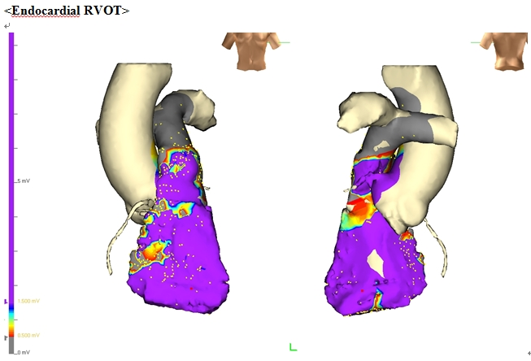
Endocardial voltage mapping
Case Rep Cardiol 2018;2018:5980380

Slide 26
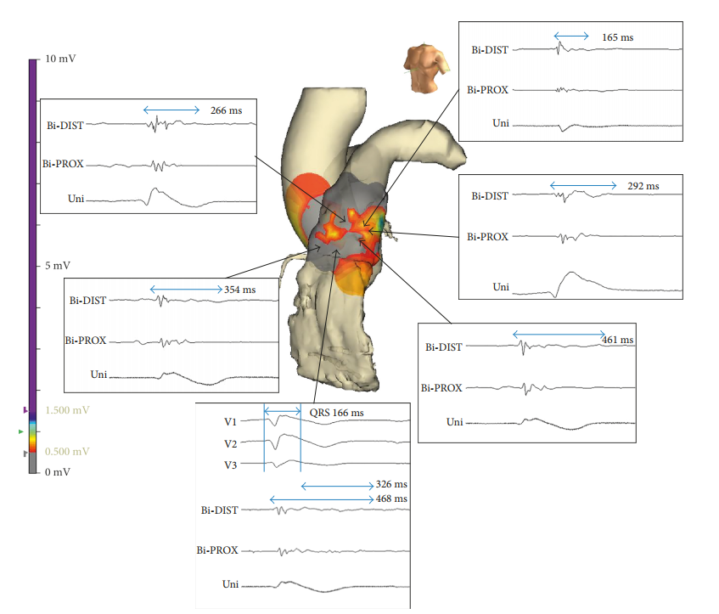
Epicardial substrate mapping
Case Rep Cardiol 2018;2018:5980380
Notes:
B, Lead V 1 and V2 of the 6 patients who had QRS notch in lead V 1. Patients 1 to 5 had a notch at the S wave (particularly at the nadir S wave), whereas patient 6 had a notch at the end of the S wave. All these patients had VF recurrence after endocardial ablation.

Slide 27
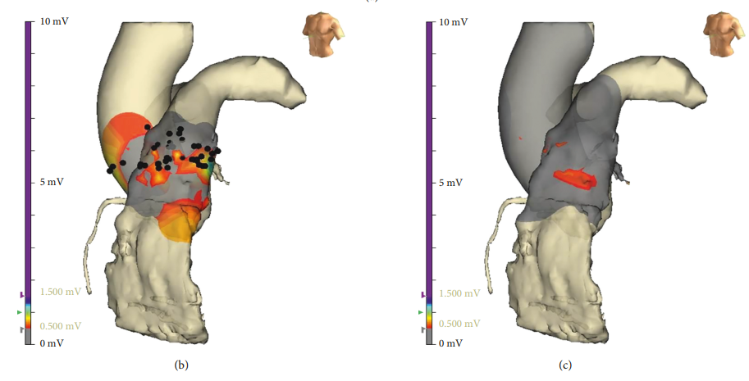
Scar change after ablation
No significant change after flecainide infusion (2mg/kg)
No inducibility of VF
Case Rep Cardiol 2018;2018:5980380
Notes:
An evaluation for the remnant substrate was performed after ecainide infusion (2 mg/kg for 10 minutes), revealing no signicant changes in local amplitude in epicardial RVOT

Slide 28
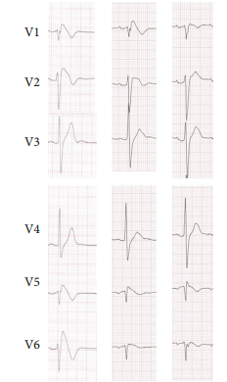
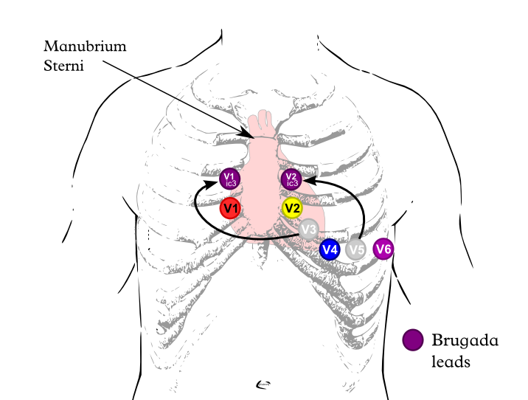
ECG changes after ablation
VF free for 30 months
High precordial leads; 3rd intercostal space
Case Rep Cardiol 2018;2018:5980380
baseline
3 days
1 month
Notes:
e STsegment elevation in a Brugada syndrome patient is the most prominent in the leads overlying the RVOTand closely follows its anatomic position
Regional epicardial brosis and electrocardiogram abnormalities aecting the RVOT correspond to the high precordial leads where the Brugada phenotype is best seen and also an ablation eect is best seen in our patient.

Slide 29
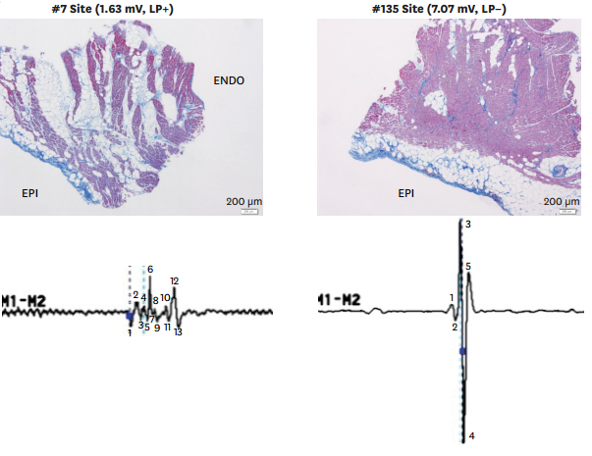
Epicardial biopsy and histology
Late potential+
Late potential-
Talib AK et al, Korean Circ J 2020;50:289-301
Notes:
Epicardial substrate characteristics
Epicardial biopsy and histology shows epicardial fibrosis with focal finger-like projections of collagen into myocardium while EGM-free areas revealed neither abnormal potential nor myocardial fibrosis.

Slide 30
Methods to enhance epicardial functional substrate
Flecainide 2mg/kg 10 minutes
Ajmaline 1mg/kg 5 minutes
Epicardial warm water instillation
Pilsicainide 1mg/kg
Irrigation catheter, contact-force based catheter, high density mapping
Notes:
procainamide infusion (10 mg/kg), propafenone

Slide 31
Endpoint of epicardial ablation
VT/VF non-inducibility or normalization of the Brugada ECG pattern during the ablation procedure was the initial epicardial ablation endpoint
To eliminate all substrate areas with low voltage fractionated signals/late potentials that can be detected by sodium channel blockade.
Notes:
Resolution of J point elevation despite pharmacologic provocation

Slide 32
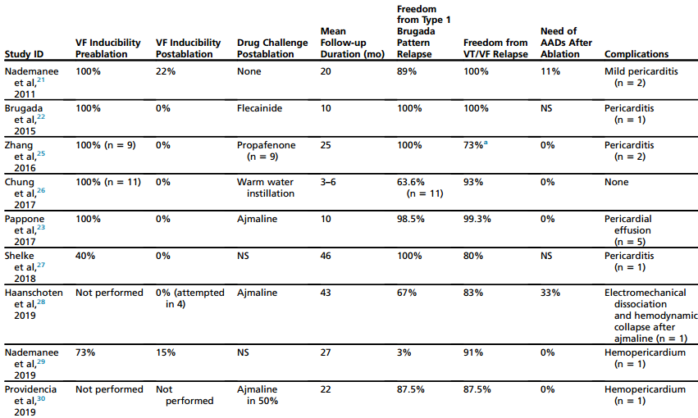
Outcome after catheter ablation
VF free rate

Slide 33
Hybrid minithoracotomy for zero-fluoroscopy
Lt periareolar incision
Cecchini F et al, Heart Rhythm Case Reports 2022;8:562-566

Slide 34
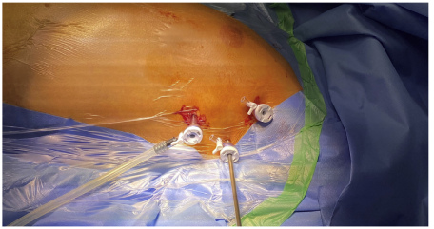
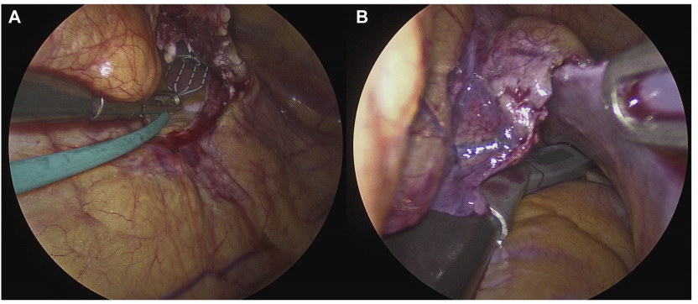
Hybrid surgical ablation, recurrent VT
Left-sided thoracoscopy
Eltsov I et al, JACC Case Reports 2022;4:214-220

Slide 35
Summary
In patients with BrS experiencing recurrent ICD shocks for polymorphic VT, intensification of therapy with quinidine or catheter ablation is recommended
BrS patients have a well-defined arrhythmic substrate at RVOT.
Catheter ablation with endpoints of elimination of all abnormal potentials before and after sodium channel blocker
Notes:
Ablation strategy; nonindcibility of VF, acute normalization of Brugada ECG

Slide 36
Gachon University Gil Medical Center Cardiovascular Center
Thank you!!

